Slide 1


Slide 2


Slide 3
Project Content
Introduction
Import Libraries
Loading Data
Data Exploration (EDA)
Data Preprocessing
Train and Test Split
Standard Scaler
Model Building and Evaluation
Model Comparison
Observation

Slide 4
Introduction
In financial services, especially with mobile money transactions, privacy concerns often limit public dataset availability. To address this, a synthetic dataset was created using the PaySim simulator, providing data for fraud detection research in scenarios where real data is scarce.
The dataset is based on a sample from one month of transaction logs provided by a multinational mobile financial service provider operating in over 14 countries.
The columns are: step, type, amount, nameOrig, oldbalanceOrg, newbalanceOrig, nameDest, oldbalanceDest, newbalanceDest, is Fraud, isFlaggedFraud.

Slide 5
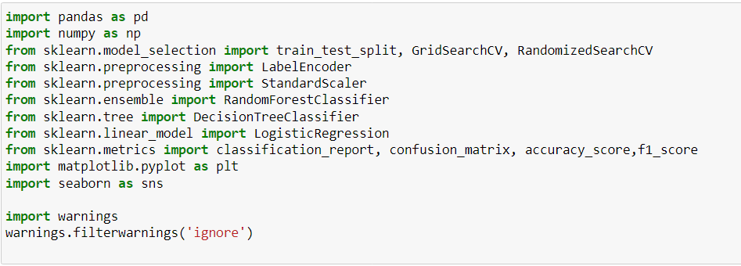
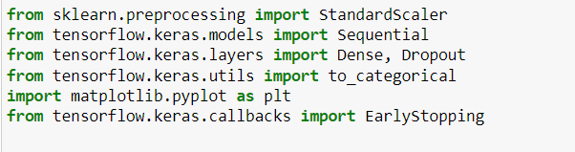
Importing Libraries
Import the libraries required for data processing and visualization.

Slide 6
Loading Data
Reading a CSV file from the provided directory and assigning it to the pandas Data Frame 'data'.

Slide 7
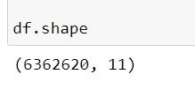
Data Exploration
df.Shape:The attribute returns a tuple representing
the number of rows and columns in the dataframe, giving an immediate sense of its size.
The dataset has 63,62,620 rows and 11 columns.

Slide 8
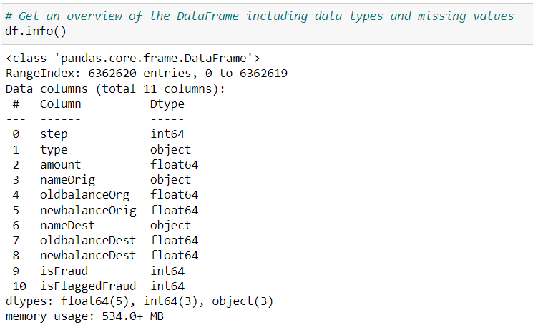
df.info(): It shows the number of rows and columns, column names, data types, and non-null counts and memory usage. Any additional information on data structure and organization. This function is useful for quickly understanding the structure of a DataFrame and identifying any missing data or memory-related concerns.

Slide 9
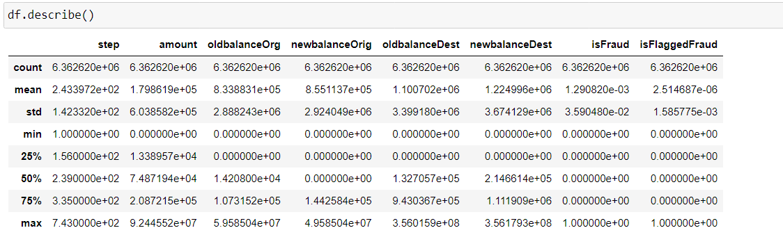
df .describe():This method provides descriptive statistics for numerical columns in a DataFrame, offering key insights into data distribution, central tendencies, and variability.

Slide 10
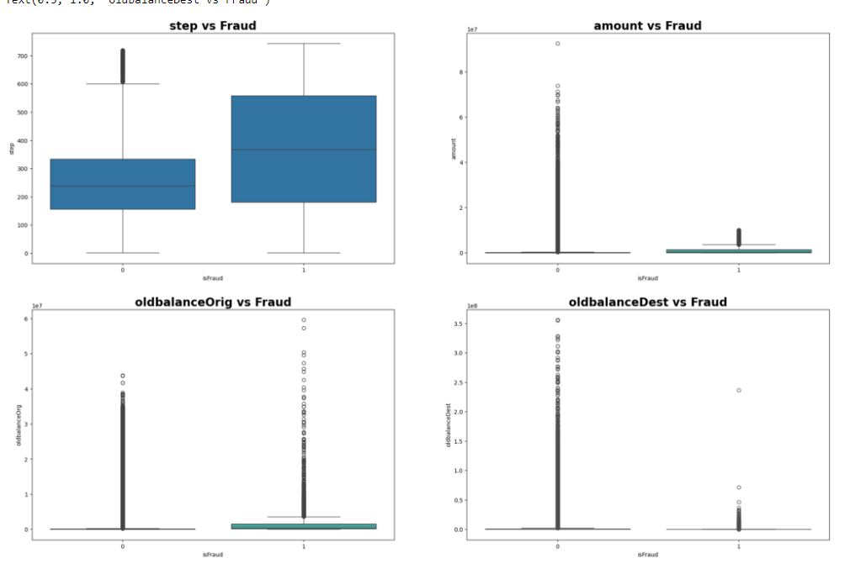
EDA Analysis of Fraud Detection

Slide 11
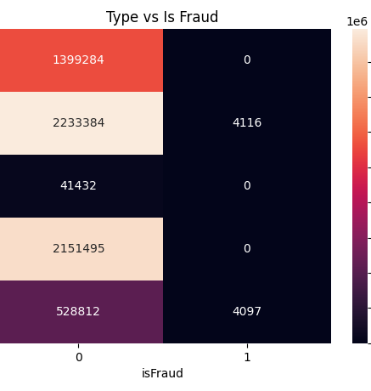
2-D Categorical Distributions
It shows the distribution of transaction types against the "isFraud" indicator, revealing that "CASH_OUT" and "TRANSFER" transactions have instances of fraud, while "CASH_IN", "DEBIT", and "PAYMENT" transactions do not.

Slide 12
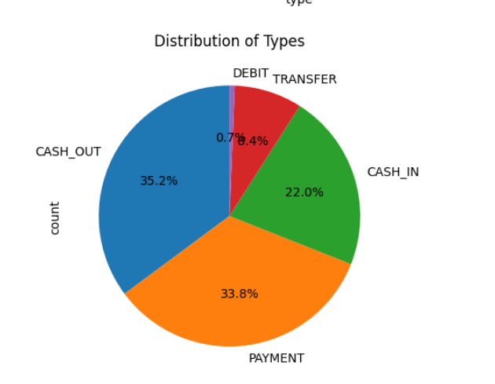
Pie chart for categorical distribution

Slide 13
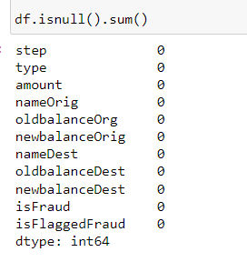
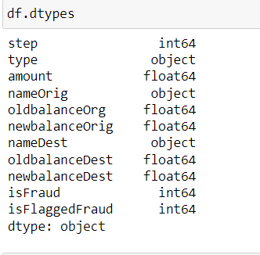
df.isnull().sum()
df.dtypes

Slide 14

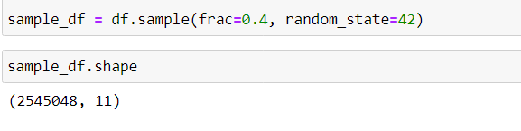
Label Encoding: converting categorical data into numerical format by assigning unique integers to each category, enabling machine learning algorithms to process categorical features.
Data Preprocessing
Sampling: This technique helps manage large datasets when computational resources are limited or when you want to create a smaller subset for exploratory analysis or training machine-learning models.

Slide 15
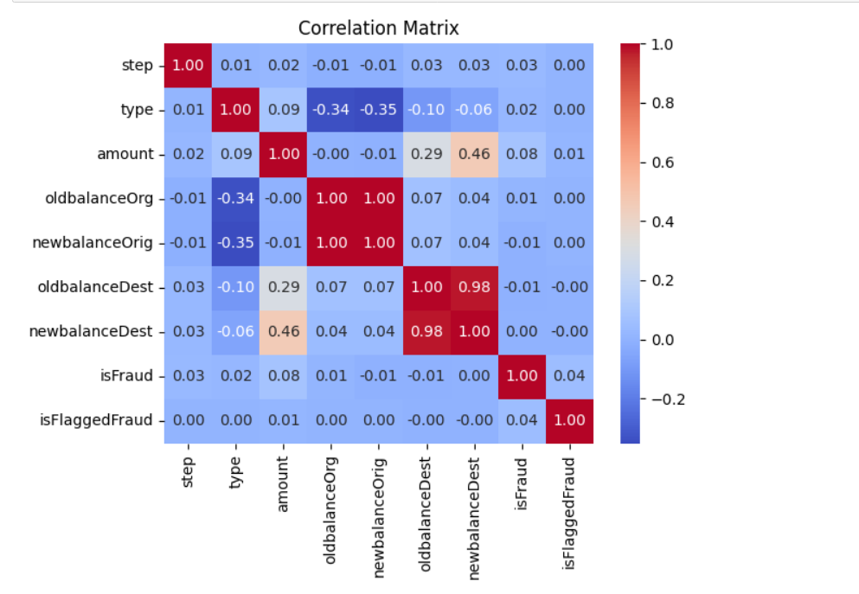
Heatmap
The correlation between isFraud and other features is generally low, indicating that no single feature strongly determines fraud. However, newbalanceDest has a notable negative correlation with isFraud.
The strongest correlations are between oldbalanceOrg and newbalanceOrig, oldbalanceDest and newbalanceDest, suggesting these features are closely related.

Slide 16
Split data into features and target

Slide 17
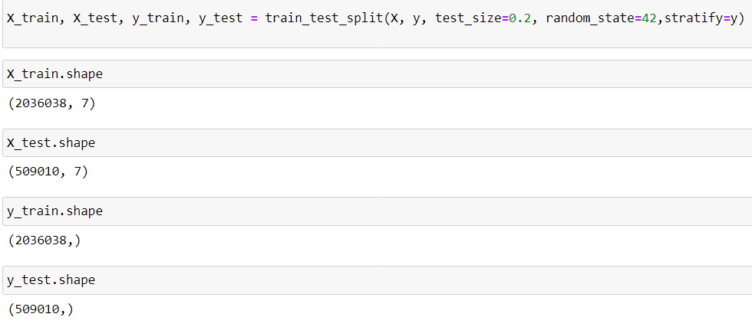
Train and Test split

Slide 18
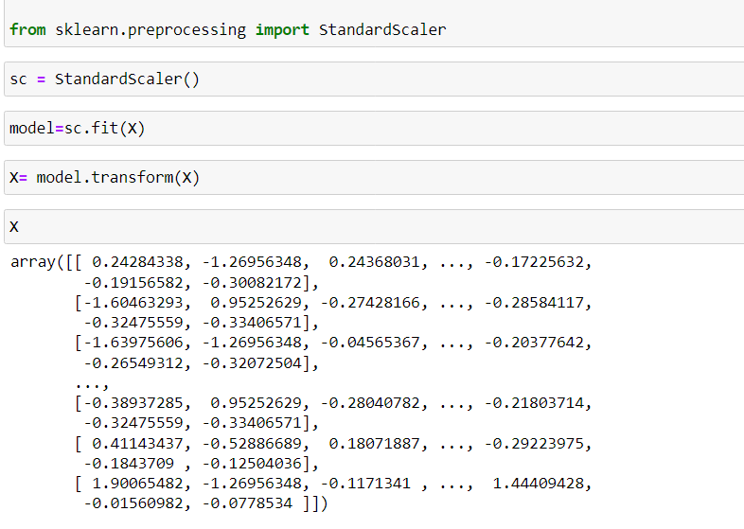
Standard Scaler standardizes features by removing the mean and scaling to unit variance, ensuring that each feature contributes equally to the model and has a consistent scale.

Slide 19
Model and Evaluation
Models used :
Logistic Regression
Decision Tree
Random Forest
Artificial Neural Networks (ANN)

Slide 20
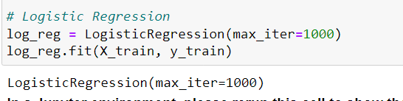
1. Logistic Regression: Logistic regression is used for binary classification tasks, modeling the probability of events such as pass/fail outcomes using a logistic function.

Slide 21
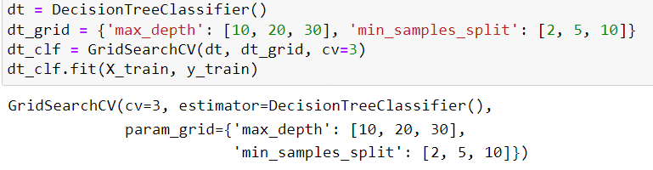
2. Decision Tree: Decision trees model decisions and their possible consequences using a tree-like graph, ideal for classification and regression tasks.

Slide 22
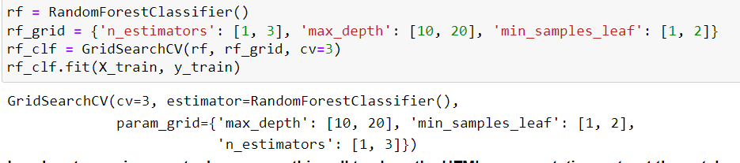
3. Random Forest: A robust ensemble technique that builds multiple decision trees and aggregates their predictions to improve accuracy and control overfitting.

Slide 23
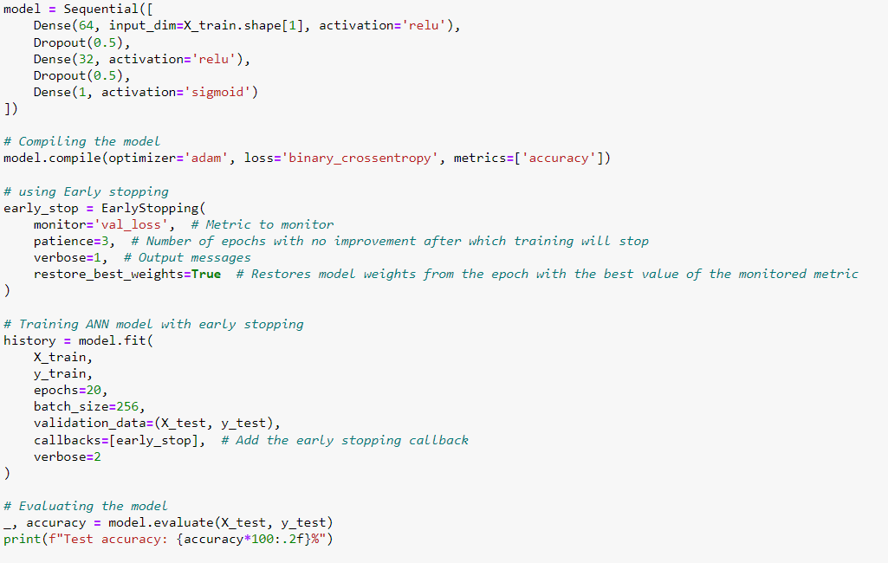
4. Artificial Neural Networks (ANN): ANNs mimic biological neural networks and are capable of learning complex patterns and functions from a large number of inputs, applicable in both classification and regression tasks.

Slide 24
Evaluation
Accuracy: Percentage of correct predictions. Good for balanced datasets but can be misleading if the dataset is imbalanced.
Precision: This metric represents the proportion of correct positive predictions among all positive predictions made by the model. It's particularly valuable in scenarios where the cost of false positives is high.
Recall: This metric indicates the proportion of true positives captured among all actual positive instances. It's essential when minimizing false negatives is a priority.
F1 Score: Harmonic mean of precision and recall. Balances the two for an overall measure of model performance.
ROC-AUC: Evaluates the trade-off between true positive rate and false positive rate, providing a robust measure of performance regardless of class imbalance.

Slide 25
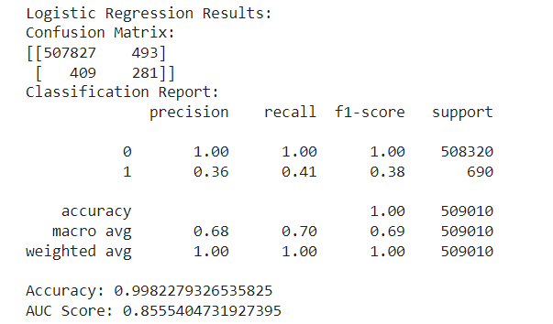
Model Comparison Based on Evaluation Metrices
Logistic Regression

Slide 26
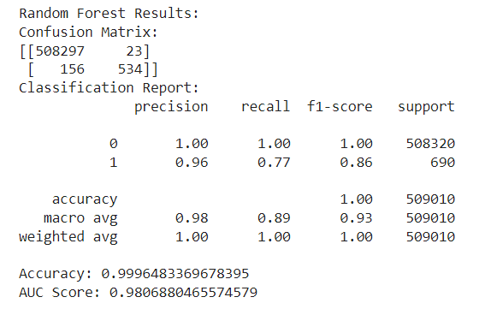
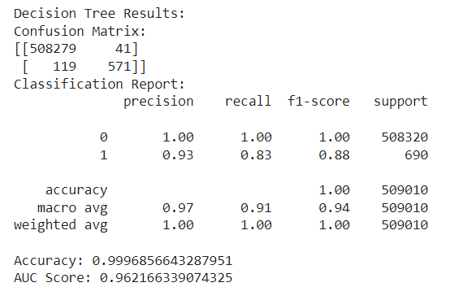
Random Forest
Decision Tree

Slide 27
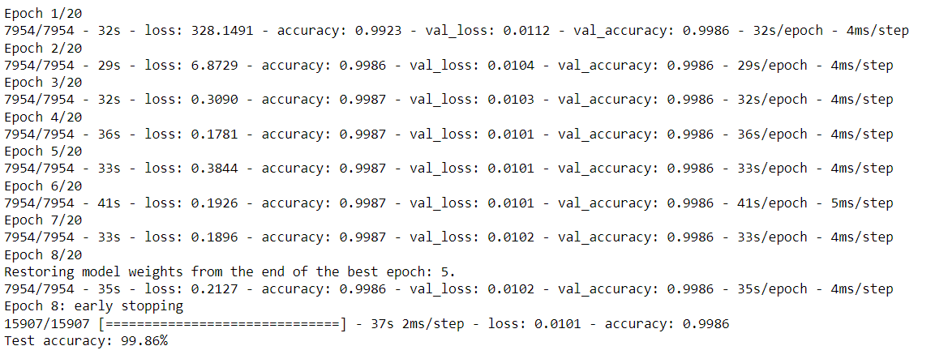
Artificial Neural Network

Slide 28
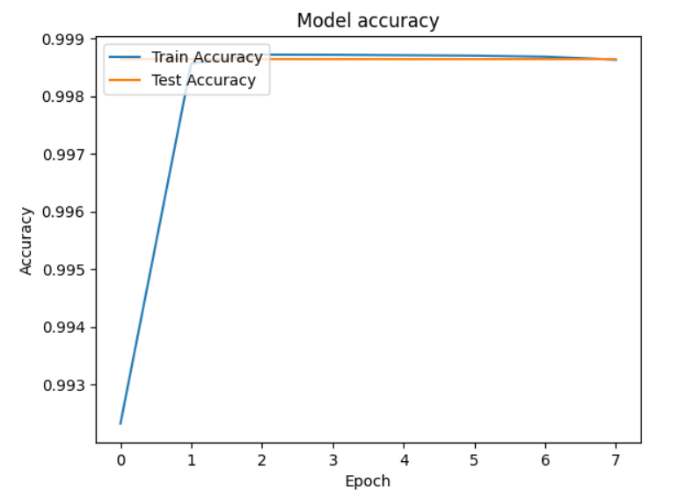

Slide 29
Observation
Given the data is large and imbalanced, handling minority
class predictions is crucial. Based on the observations:
The Random Forest and Decision Tree models show high overall accuracy, but they struggle with the imbalanced data, indicated by the lower F1-scores for the minority class.
The Artificial Neural Network Model provides consistent accuracy with a decreasing loss over time. This suggests it might be better suited for imbalanced datasets.
Thus Artificial Neural Network Model appears to be the best choice. It demonstrates robustness across various metrics and consistent performance, indicating it can handle large, imbalanced datasets better than other models.

Slide 30
Thank You!!

